Slide 1
AIPI 540 – Team #2 Presentation: Computer Vision Identifying Disasters from Different Perspectives Amani Johnson-Singh-Barnett Stephanie Horng Colin Bryan
Notes:
For our project, we explored the feasibility of personalized prediction tool for patient with AD and memory impairment.

Slide 2
Table of Contents
Introduction
Define the Problem
Purpose & Objective
Gather Data
Validate & Explore Data
Data Preparation
Model Selection & Analysis
Evaluation of Results
Conclusion
Citations
Notes:
The organization of this presentation follows the CRISP-DM steps outlined here – that we’re all familiar with.

Slide 3
Introduction
Background & Situation
With the increasing adoption of social media and aerial drones across the globe, there is an opportunity for artificial intelligence to analyze images in disaster-prone areas and identify disaster events in real-time.
Recent research in disaster informatics demonstrates a practical and important use case of artificial intelligence to identify disasters in real-time to aid emergency personnel in coordinating first response.

Slide 4
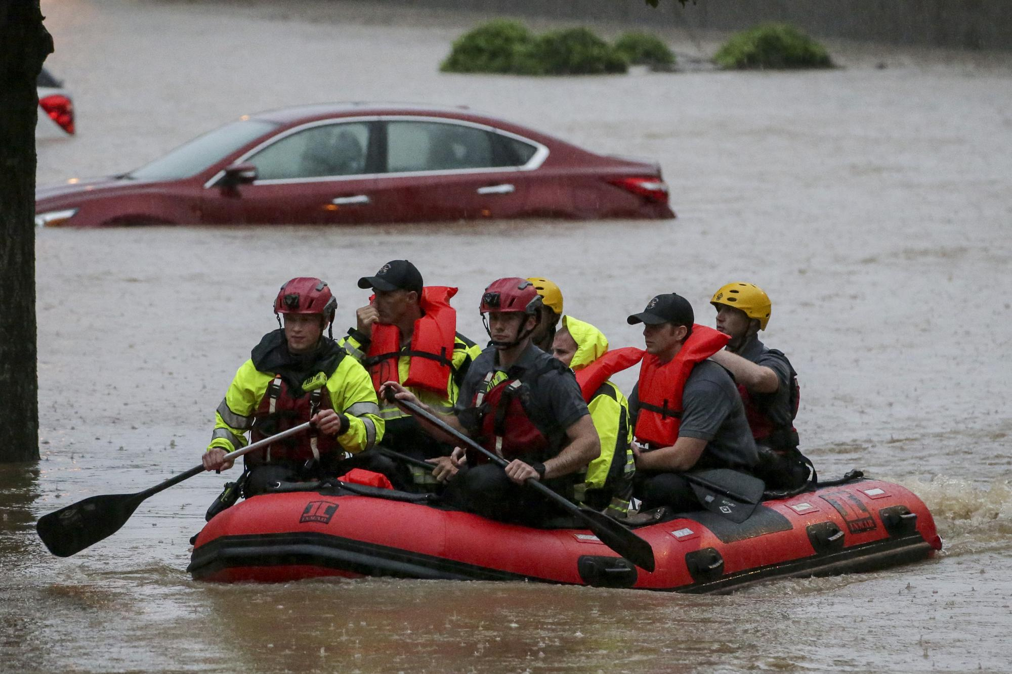
Define the Problem
Natural disasters are increasingly common today compared to history* and are putting a strain on the resources of emergency first responder organizations.
According to OCHA (the United Nations Office for the Coordination of Human Affairs), the first 72 hours of disaster response are critical.**
Emergency organizations need technological advantages to handle the increasing volume of natural disasters and reduce humanitarian impact.
* Source: Link
** Source: Link

Slide 5
Purpose & Objective
Aerial Example
Aerial example
Purpose: Classify images by disaster type to understand how neural network applications can lead to valuable tools for emergency response and disaster management applications. To limit the scope of our model for this proof of concept, we focused on classifying images as a fire, flood, or non-disaster.
Objective: Deploy a neural network model as a proof of concept to identify a subset of natural disasters regardless of image vantage point.
Ground-Level Example
Ground Example

Slide 6
Gather Data: Aerial Dataset
Dataset One: “AIDER”
Source: Deep-Learning-Based Aerial Image Classification For Emergency Response Applications Using Unmanned Aerial Vehicles(3.1 dataset collection)
Dataset was compiled through manual collection of images of disaster events*:
521 images of fire/smoke**
526 images of flood**
320 images of collapsed buildings/rubble
335 images of traffic accidents
4390 images normal case**
* Image sources: world-wide-web, google images, Bing images, YouTube, news agencies web sites, other databases of general aerial images, images collected using the author’s own unmanned aerial platform
** Highlights indicate use in Team 2’s computer vision project

Slide 7
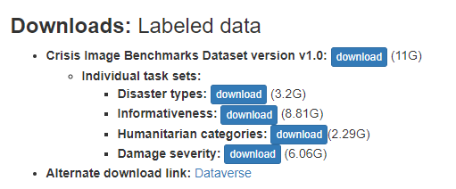
Gather Data: Ground-Level Dataset**
Dataset Two: “MEDIC”
Source: MEDIC: A Multi-Task Learning Dataset for Disaster Image Classification(Table 4)
*Image sources: Crisis Benchmark: images from Twitter, Google, Bing, Flickr and Instagram
**In manual exploration of dataset, over 95% of images were noted to be from ground-level
*

Slide 8
Validate & Explore Data
MEDIC and AIDER
Evaluated datasets for similarities and differences in preparation for combining into one training set
Considerations: To limit the scope of our model for this proof of concept, we focused on classifying images as a fire, flood, or non-disaster. Although this “non-disaster” label may be misleading for images of other disaster types, the aerial image dataset and ground-level image dataset we used for this project only overlapped on fires and floods. Thus, those were the labels we used for our training data.
Maintained class imbalance between aerial and ground images for realistic application (i.e., more images will be submitted from ground-level than aerial vantage point)
Analyzed differences in labels between datasets to inform data preparation. MEDIC’s labeling was more built-out than AIDER’s labeling
Missing images in MEDIC dataset were noticed and filtered out in data preparation phase

Slide 9
General process flow
Update from Amani’s process flow

Slide 10
Data Preparation
Reference comments in code to translate to data preparation steps
Split data for training and validation for all three datasets
3 Classes: flood, fire, normal
Scaled/normalize data
Set up class to add labels, manipulate images to size correctly, data augmentation for training purposes
Filtered out only fire, flood and normal from appropriate folders
Removed missing images from datasets

Slide 11
Data Preparation: AIDER
Original file structure:
Folders labelled “fire”, “flood”, “normal”
Manually reorganized file structure in order to use ImageFolder to create datasets
“train” and “val” folders, each with “fire”, “flood”, “normal” folders
Split about 80/20 for train/val:
Train: 421 fire (#101-521), 426 flood (#101-426), 3390 normal (#1001-4390)
Val: 100 fire (#1-100), 100 flood (#1-100), 1000 normal (#1-1000)

Slide 12
Data Preparation: MEDIC
Read in tsv files as dataframe:
consolidated_disaster_types_train_final.tsv
consolidated_disaster_types_test_final.tsv
Filtered for rows with values “flood”, “fire”, “not_disaster” for “class_label” column
Filtered for columns “image_path” and “class_label”
Filtered for rows that have corresponding images for their paths
Generate datasets using custom dataset class

Slide 13
Data Preparation: Combined
Create train and val dataframes with AIDER image paths and class labels and concatenate it with the corresponding filtered MEDIC train and val dataframes
Ex. AIDER flood val folder has the first 100 images labelled “flood_image_0001.jpg” ,…, “flood_image_0100.jpg”
All AIDER folders have similar filename structures
Generate image paths using the given range/bounds with string formatting
To standardize labels, images with the “normal” class will
have the label “not_disaster”
Use same custom dataset class MEDIC uses

Slide 14
Model Selection & Analysis
Model Selection: ResNet50 and transfer learning
From reading and research, we decided on using a pre-trained ResNet50 model with transfer learning for our project
Model Analysis:
MEDIC-obtained results
AIDER-obtained results
Combined both datasets-obtained results
Compare MEDIC, AIDER, combined datasets performance
Update with model selection reasoning & analysis/screenshots

Slide 15
Evaluation of Results
MEDIC
AIDER
Combined
Amani to send

Slide 16
Conclusion
Validation metrics are higher than training metrics
Model trained in 1 hour 40 minutes and 57 seconds, 36 images for the 25 epochs
Amani to send

Slide 17
MEDIC Citations
Firoj Alam, Ferda Ofli, Muhammad Imran, Tanvirul Alam, Umair Qazi, Deep Learning Benchmarks and Datasets for Social Media Image Classification for Disaster Response, In 2020 IEEE/ACM International Conference on Advances in Social Networks Analysis and Mining (ASONAM), 2020. [Bibtex] [Arxiv]
Firoj Alam, Ferda Ofli, and Muhammad Imran, CrisisMMD: Multimodal Twitter Datasets from Natural Disasters. In Proceedings of the 12th International AAAI Conference on Web and Social Media (ICWSM), 2018, Stanford, California, USA. [Bibtex]
Hussein Mozannar, Yara Rizk, and Mariette Awad, Damage Identification in Social Media Posts using Multimodal Deep Learning, In Proc. of ISCRAM, May 2018, pp. 529–543.

Slide 18
AIDER Citations
C. Kyrkou and T. Theocharides, "Deep-Learning-Based Aerial Image Classification for Emergency Response Applications Using Unmanned Aerial Vehicles," 2019 IEEE/CVF Conference on Computer Vision and Pattern Recognition Workshops (CVPRW), 2019, pp. 517-525, doi: 10.1109/CVPRW.2019.00077.

